Slide 1
Denver Crime: Analysis and ML
By Radjamin Hukom

Slide 2
Background (It’s kind of necessary)

Slide 3
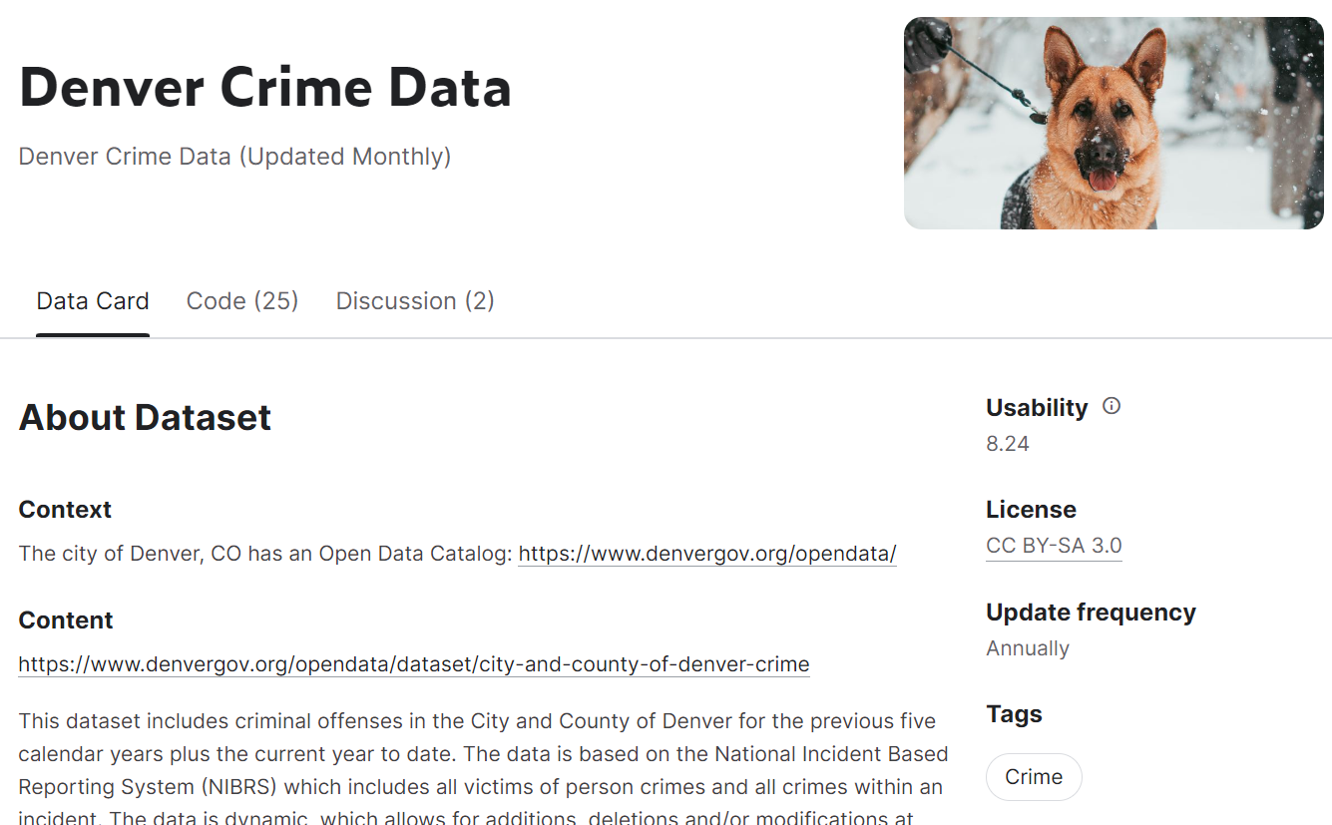
About the dataset
Notes:
The data set documents criminal offenses in the city and county of Denver. It is a data set that is continually renewed. However, the data set is not whole as certain information is omitted due to legal requirements. The data is not without errors as it relies on data that cannot always be verified. The data set omitted sexual assault, child abuse, juvenile perpetrators, victims, and witnesses of certain crimes due to legal restrictions.
It is not stated explicitly in the data card why this information is collected other than for documentation purposes. It is also not clear what potentially useful information in the data set that is being sought by the city of Denver. However, by looking at the data set, a clear directive to investigate which factors correlating with (or even causing) crime seems obvious.

Slide 4
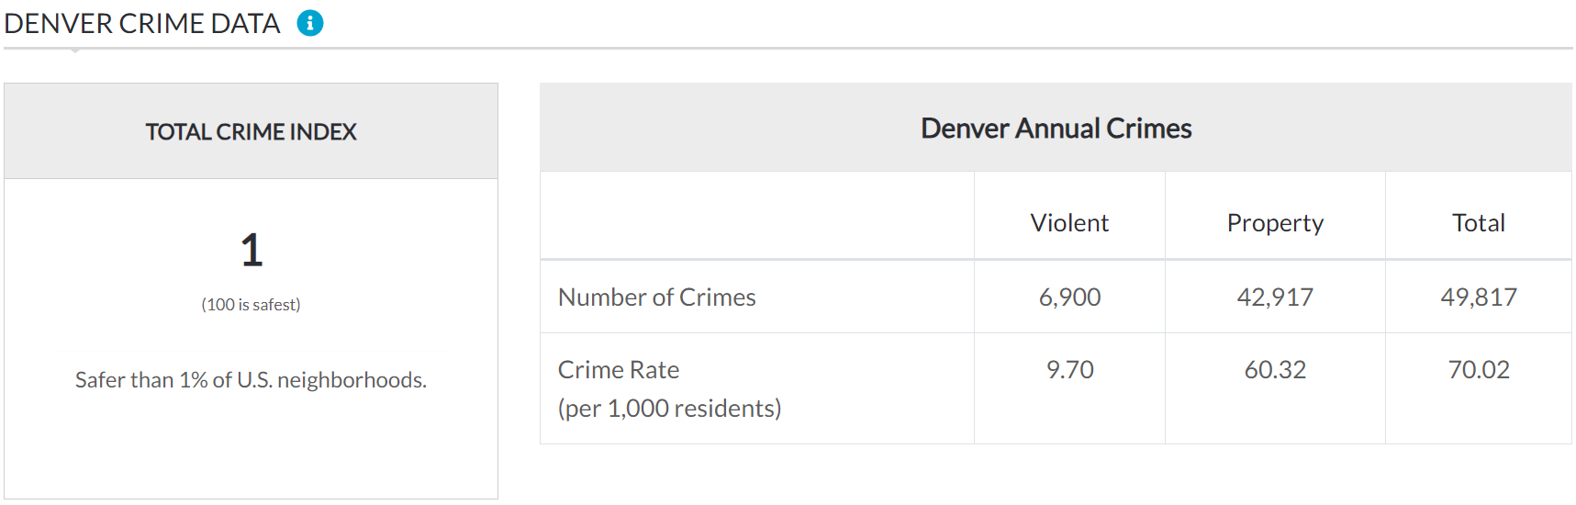
About Denver (neighborhoodscout.com)

Slide 5
Objective
Find out what factors correlate with crime in Denver
Make an ML to use those factors to predict district_id (a location variable) or offense_category_id (a crime type variable)

Slide 6
Preprocessing
Enable the program to read the data
Drop unwanted columns [‘incident_address’, ‘is_crime’, ‘is_traffic’, ‘victim_count’, ’neighborhood_id’, ‘last_occurrence_date’, ‘precinct_id’]
Fix the null values by fillna [‘district_id’] or by dropna [‘geo_x’, ‘geo_y’, ‘geo_lon’, ‘geo_lat’]
First_occurrence_date → fid (date), fid_time (time), fid_part (AM or PM), fid_day (day of week)
reported_date → rd, rd_time, rd_part, rd_day
Offense_category_id → offense_category_num

Slide 7
Visuals (at last!)

Slide 8
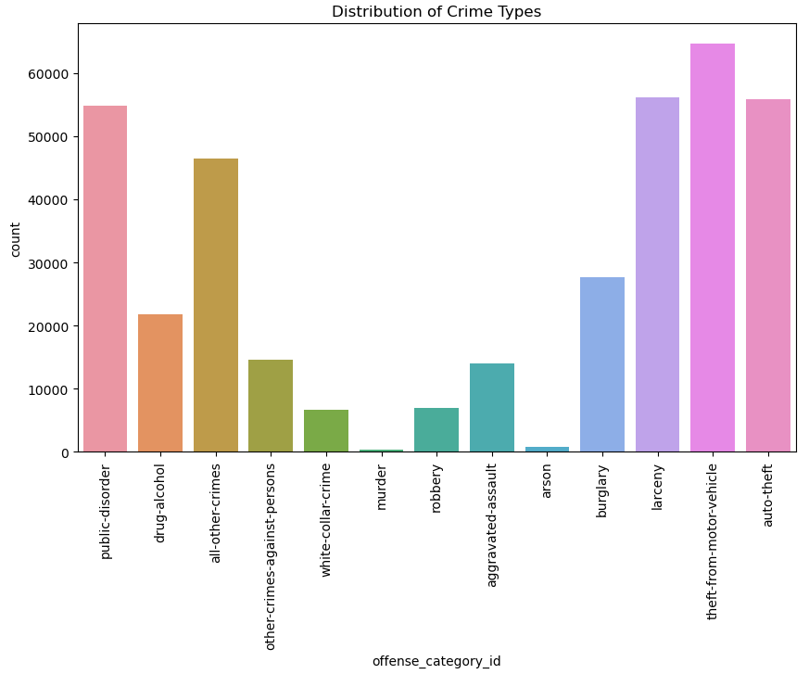
Distribution of Crime Types

Slide 9
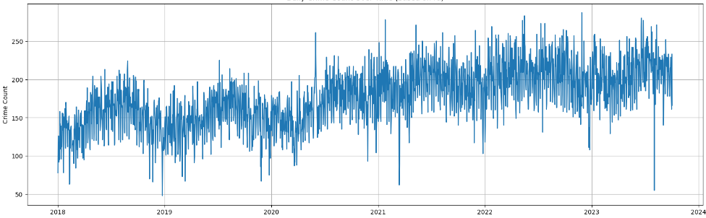
Daily Crime Count Over Time (based on rd)

Slide 10
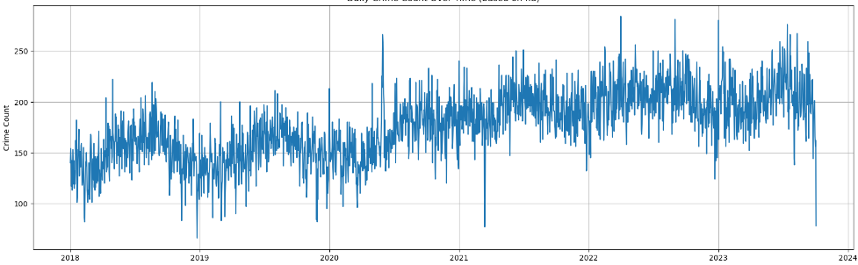
Daily Crime Count Over Time (based on fid)

Slide 11
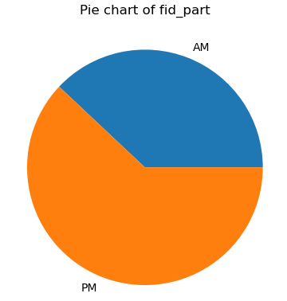
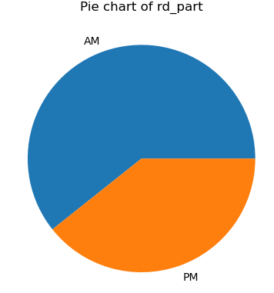
Time (part)

Slide 12
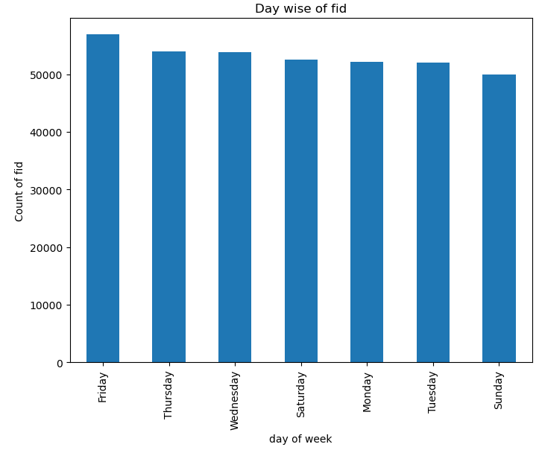
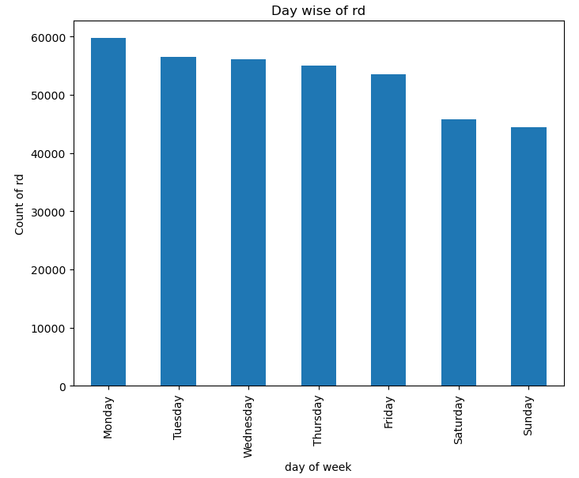
Time (day)

Slide 13
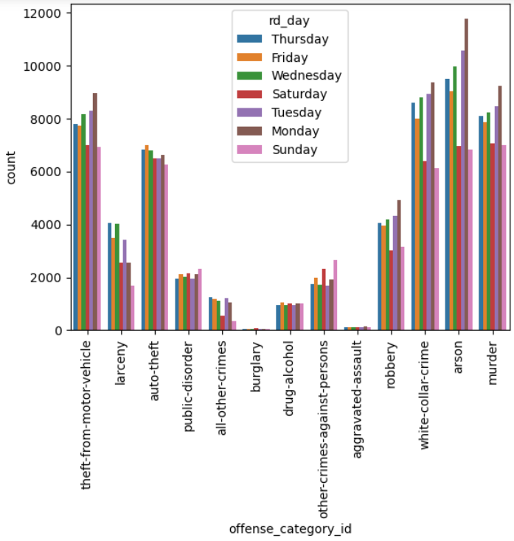
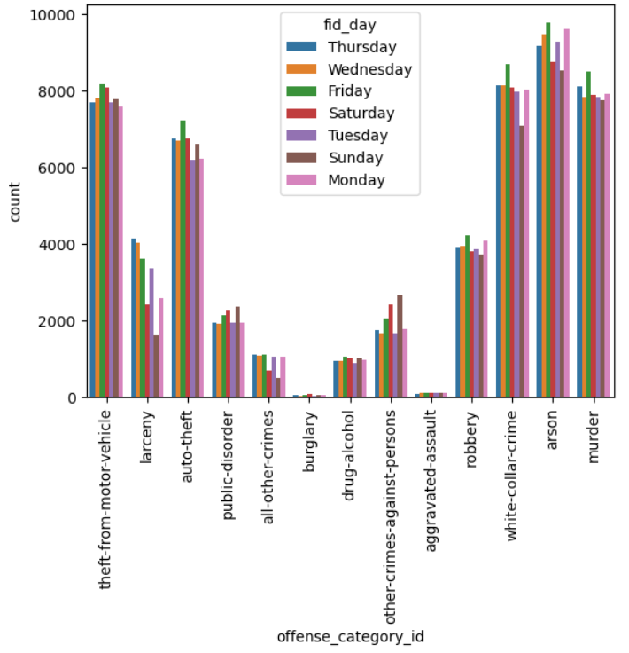
Offense_category_id vs. count of fid_day or rd_day

Slide 14
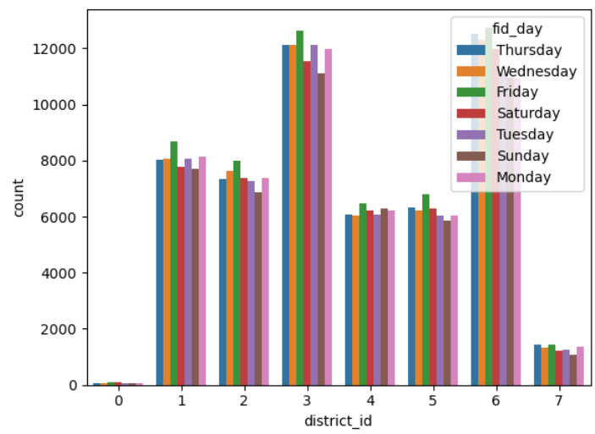
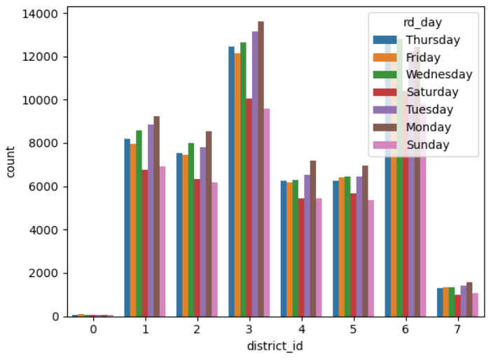
District_id vs. count of fid_day or rd_day

Slide 15
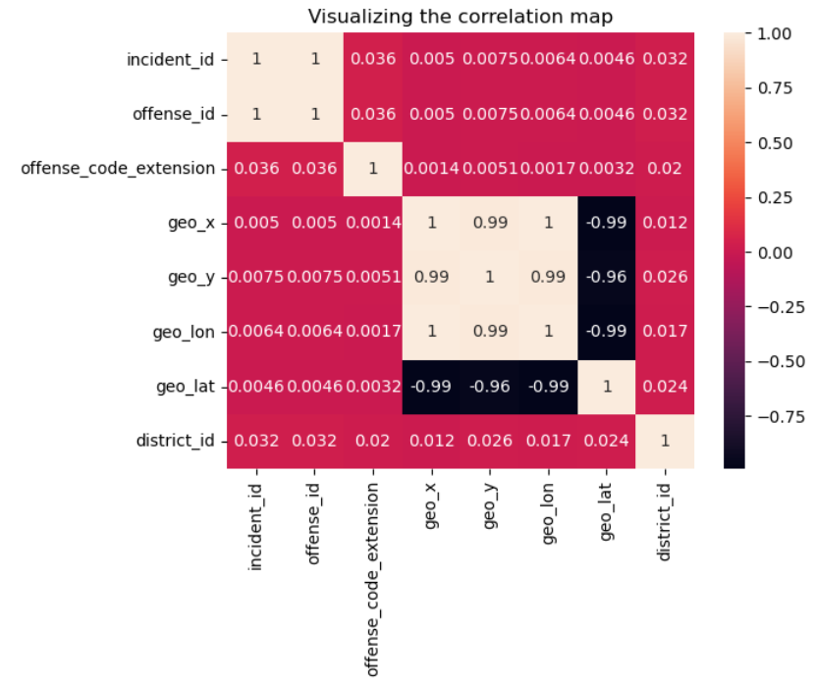

Slide 16
ML models (close your eyes)

Slide 17
Experimental Design
x = ds[['incident_id', 'offense_id', 'offense_code_extension', 'geo_x', 'geo_y',
'geo_lon', 'geo_lat', 'district_id']]
y = ds[[‘offense_category_num’]]
Table 2: Experiment Parameters
Experiment Number | Parameters
1 | All 8 raw features with 66/16.5/16.5 split for train, validate, and test
2 | All 8 raw features with 80/10/10 split for train, validate, and test
3 | All 8 raw features with 50/25/25 split for train, validate, and test

Slide 18
Experimental Design
x = ds[['incident_id', 'offense_id', 'offense_code_extension’, ‘offense_category_num’, 'geo_x', 'geo_y',
'geo_lon', 'geo_lat', 'district_id']]
y = ds[[‘district_id’]]
Table 3: Experiment Parameters
Experiment Number | Parameters
1 | All 8 raw features with 66/16.5/16.5 split for train, validate, and test
2 | All 8 raw features with 80/10/10 split for train, validate, and test
3 | All 8 raw features with 50/25/25 split for train, validate, and test

Slide 19
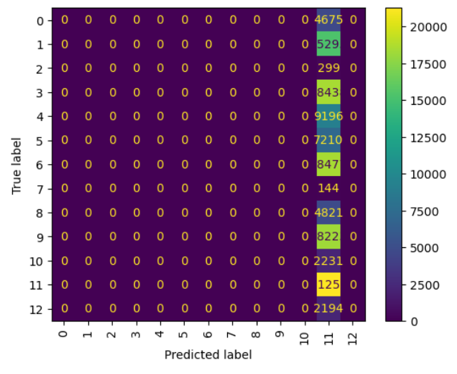
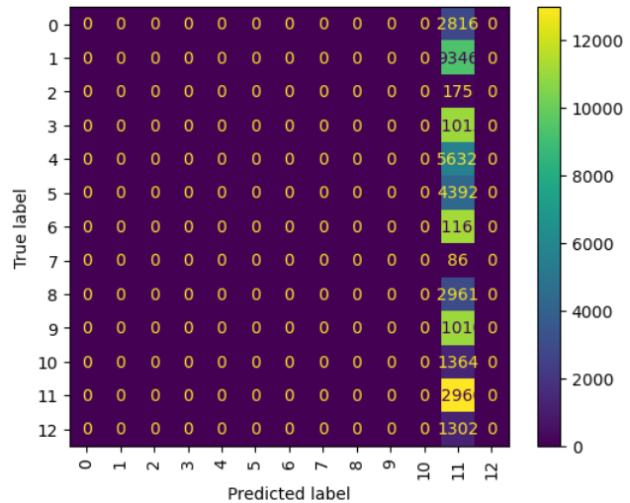
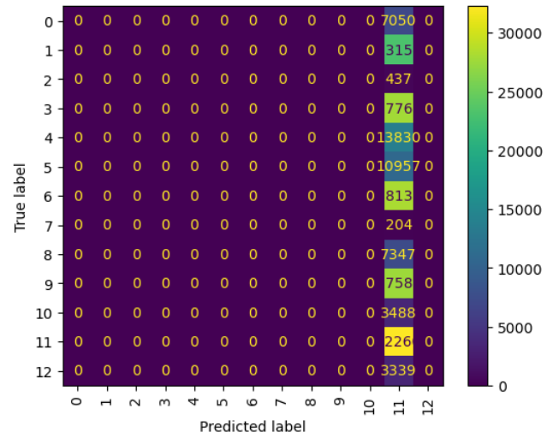
The confusion matrices of 1,2,3

Slide 20
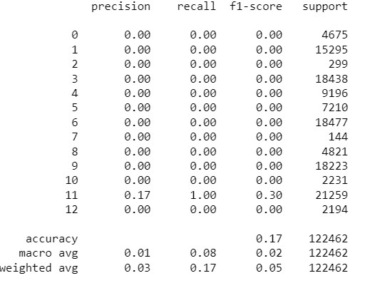
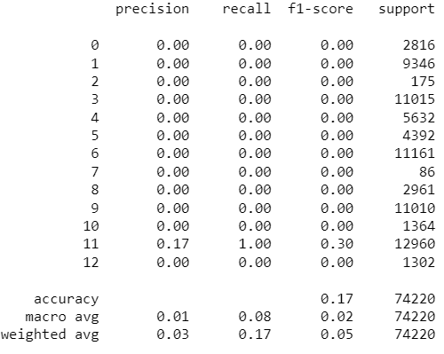
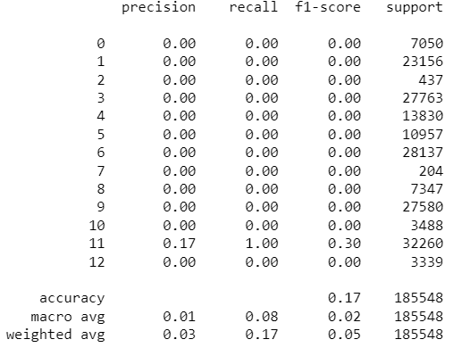
Reports for 1,2,3

Slide 21
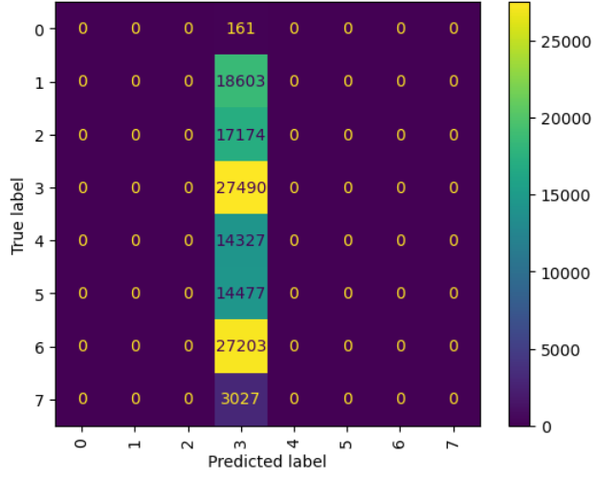
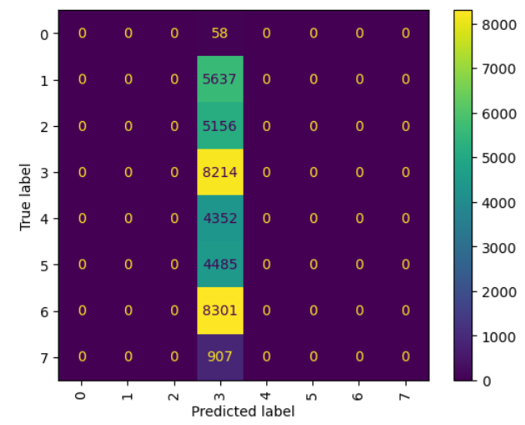
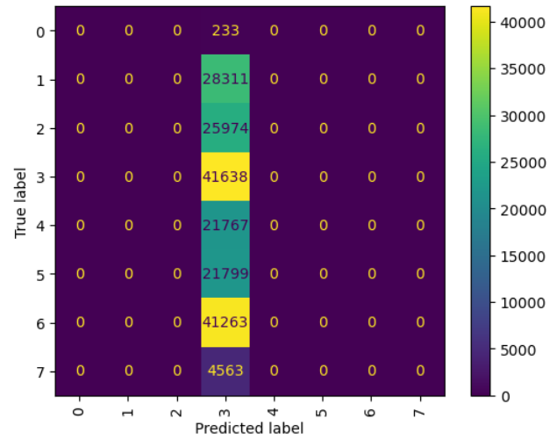
The confusion matrices of 4,5,6

Slide 22
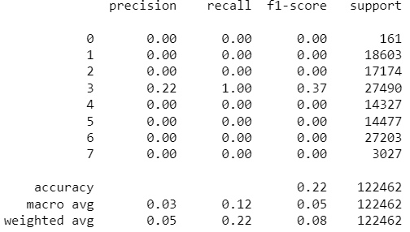
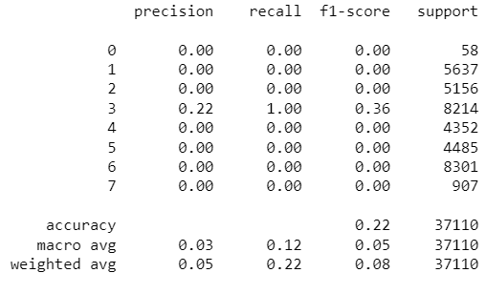
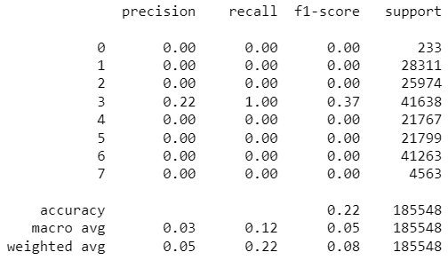
Reports for 4,5,6

Slide 23
Post-project reflection

Slide 24
Problems encountered
Big dataset size (need better equipment)
Not able to have enough time to make better logistic regressions and maps

Slide 25
Possible improvements
Need more work
Need better preparation
Need more goal-oriented planning
Possible method to produce better logistic regression
Interactive maps for more visualization

Slide 26
Conclusions
Managed to glean useful information through thorough preprocessing and data visualizations
Did not manage to produce usable logistic regression models

